Slide 1

2024-2025
State of the School
Mid-Year Presentations
January 2025
THE Boca Ciega High School

Slide 2


The vision of BCHS is 100% student success.
The mission is to open doors of success.
Notes:
Est. less than a minute
Welcome to the official opening of the 2024-2025 school year. This year we will continue with our vision of 100% student success and our mission to open doors of success for our students.

Slide 3
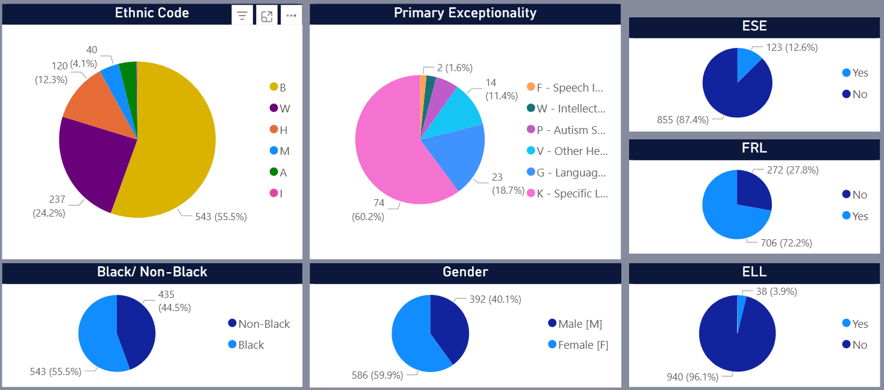
School Profile – January 2025
Total
Enrollment
978

Slide 4
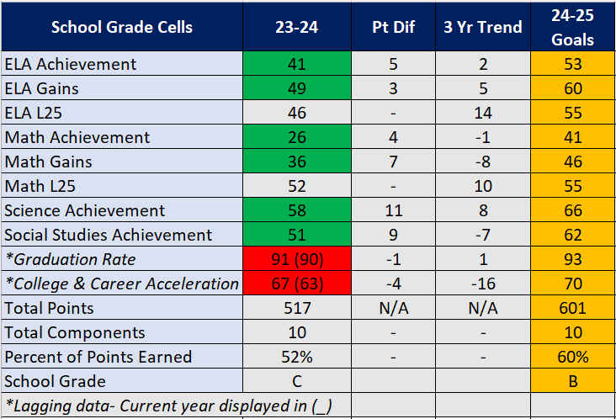

Slide 5
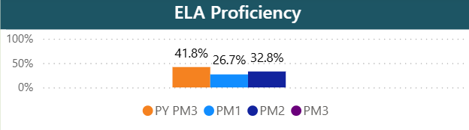
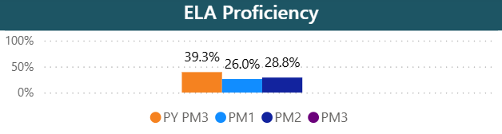
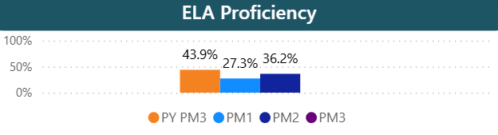
Progress Monitoring: ELA
Overall
2024-2024 SIP Goal: 53%
Mid-Year Action Steps
  Data based schedule adjustments
  Teacher/admin. data chat – challenge list creation
  Teacher/Student data chats – understanding your score
  Daily classroom walk-throughs w/immediate feedback
  Team Teaching English 1 and 2
  Teachers utilizing graphic organizers, benchmark trackers, anchor charts & HS ELS Instructional Matrix (see next slide)
  District support: model lessons, collaborative planning and 2.2 pullout
  Encouragement Groups for regressors w/incentives
  BTG 2.2 and low L3 – mentor check-ins
  Level Up Luau Celebration
9th Grade
10th Grade

Slide 6
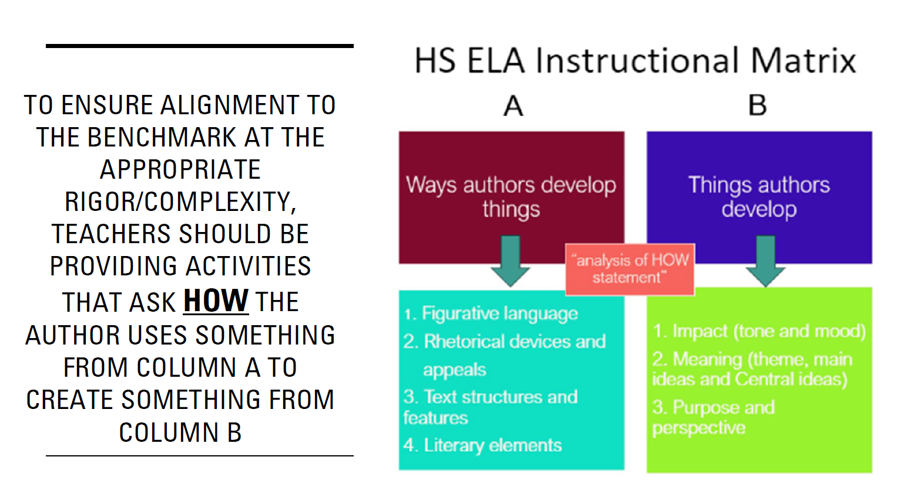

Slide 7
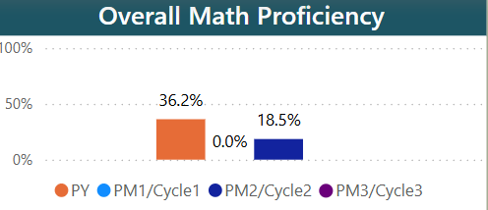
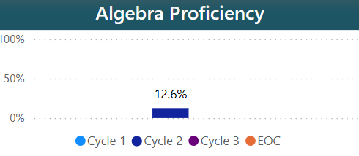
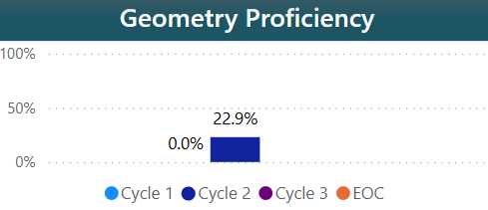
Progress Monitoring: Math
2024-2024 SIP Goal: 46%
Mid-Year Action Steps
  Data based schedule adjustments
  Teacher/Student data chats – understanding your score
  Daily classroom walk-throughs w/immediate feedback
  IXL and Aleks lessons to remediate struggling benchmarks.
  Student Reflections –data trackers
  Pullout interventions by Mr. Sager w/incentives
  District support: model lessons, collaborative planning and 2.2 pullout interventions w/incentives
  Saturday Boot-camp
  Level Up Luau Celebration

Slide 8
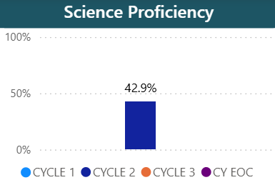
Progress Monitoring: Biology
2024-2024 SIP Goal: 66% (LY 58%)
Mid-Year Action Steps
  Data based schedule adjustments
  Admin/teacher data chats
  Analyze common error report
  Plan for remediation/reteaching
  Explicitly reteach low performing standards
  Teacher/Student data chats – understanding your score
  PM2 Science Celebration
  Utilize student success benchmark trackers
  Daily classroom walk-throughs w/immediate feedback
  Level Up Luau Celebration

Slide 9
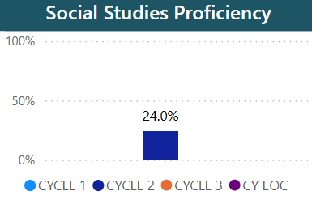
Progress Monitoring: US History
2024-2024 SIP Goal: 62% (LY 51%)
Mid-Year Action Steps
  Intensive new teacher support
  Admin/teacher data chats
  Spiral benchmark reteaching plan
  Analyze common error report
  Plan for remediation/reteaching
  Teacher/Student data chats – understanding your score
  Daily classroom walk-throughs w/immediate feedback
  Pullout interventions by Mr. Spurgeon w/incentives
  District support: model lessons, collaborative planning and 2.2 pullout interventions w/incentives
  Class competition w/whole group and individual student incentives
  Level Up Luau Celebration

Slide 10
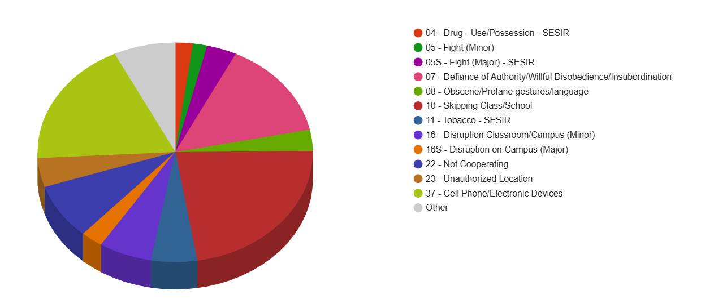
Discipline Data
Total Referrals: 769, LY - 409
Black Risk Ratio: LY - 1.72
Grade: 9th – 281, 10th – 278, 11th – 128, 12th - 84
Top Offenses:
Skipping class/school
Cell Phone/Electronics
Defiance
Not cooperating
Class/campus disruption (minor)

Slide 11
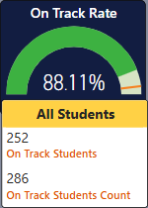
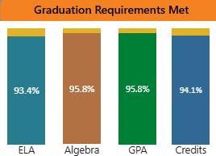



The Graduating Class of 2025

Slide 12
Good of the School
Volleyball- 4 lady Pirates made the All-Star Roster. Senior Malayna won game MVP
Volleyball PCAC Teams members – Kambre, 1st team, Kaitlyn, 2nd team and honerable mention, Ripley, India, Charlize, Jaida, Malayna and Taylor
8 Pirates received College Board National Recognition for their performance on PSAT, SAT and AP tests.
Theatre – 14 medaled pieces at districts
Business – 17 certification in Entrepreneurship and/or Adobe Certified Professional
FBLA – two students heading to states after district wins – Josiah for public speaking and Andy for entrepreneurship
Band – 4 students made the PCS All County Band – Hudson, Jean-Luc, Rebekah and Micah

Slide 13
Good of the School
BCHS received the AP Computer Science Female Diversity Award
2 students artwork selected for the Surrealist Exhibit at The Dali Museum
2 students artworks selected for the HS New Perspectives Exhibit at the Dunedin Fine Arts Center
NCNW scholarship recipient – Kaniya
9 lady Pirates received Ralph Young Scholarship
5 senior Pirates accepted to UF
3rd Place in the Guys Read HS Battle

